Slide 1
.NET
Need to knows

Slide 2
By the end of this topic, you will learn the different parts of
An ASP.NET Web Application

Slide 3
Agenda
Introduction
Getting Started
Angular CLI
Project Overview
Debug Tools
Dependency Injection

Slide 4
Need to knows
1
Book of Conventions

Slide 6
Conventions
Maybe time to create one?
and maintain it
https://docs.microsoft.com/en-us/dotnet/csharp/programming-guide/inside-a-program/coding-conventions
https://github.com/ktaranov/naming-convention/blob/master/C%23%20Coding%20Standards%20and%20Naming%20Conventions.md

Slide 7
Need to knows
2
Interfaces

Slide 8
Can someone explain interfaces without mentioning code?

Slide 9
When should you use an abstract class, when an interface

Slide 10
Need to knows
3
SOLID

Slide 11
SOLID
Notes:
https://scotch.io/bar-talk/s-o-l-i-d-the-first-five-principles-of-object-oriented-design
https://en.wikipedia.org/wiki/Robert_C._Martin
S.O.L.I.D is an acronym for the first five object-oriented design(OOD)** principles** by Robert C. Martin, popularly known as Uncle Bob.
These principles, when combined together, make it easy for a programmer to develop software that are easy to maintain and extend. They also make it easy for developers to avoid code smells, easily refactor code, and are also a part of the agile or adaptive software development.

Slide 12


Slide 13
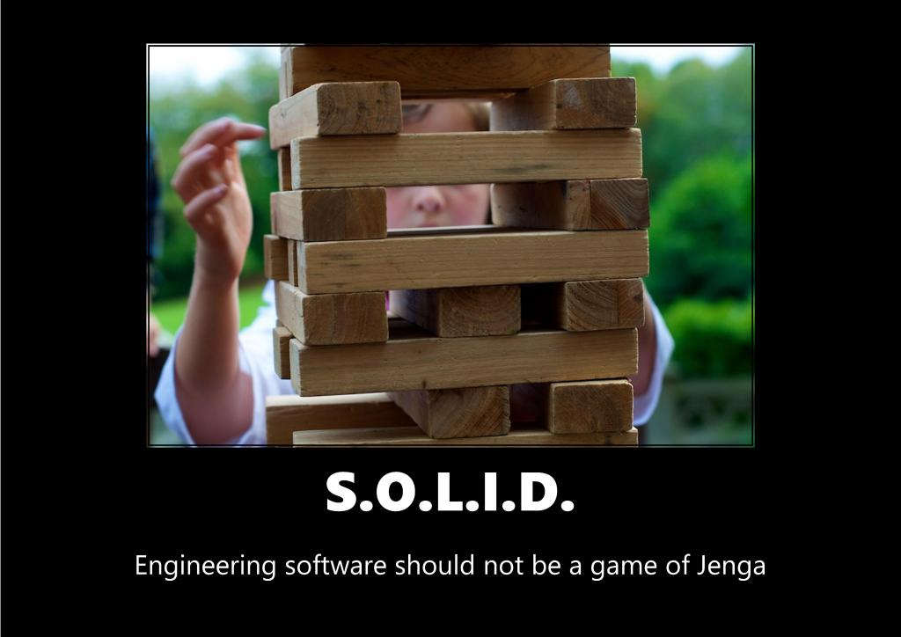

Slide 14
SOLID
Single-responsibility principle

Slide 15
SOLID
Open-closed principle

Slide 16
SOLID
Liskov substitution principle

Slide 17

Barbara Liskov
SOLID
Liskov substitution principle

Slide 18
SOLID
Interface segregation principle

Slide 19
SOLID
Dependency Inversion Principle

Slide 20
SOLID
Single-responsibility principle

Slide 21
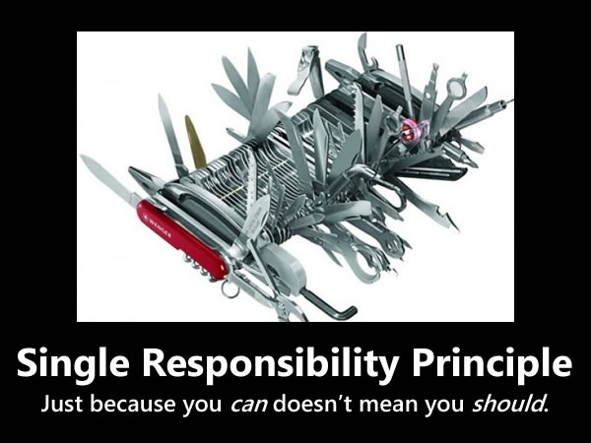

Slide 22
Single-responsibility Principle
A class should have one and only one reason to change,
meaning that a class should have only one job
Do one thing
Do that thing only
Do that thing well
Responsibility
A reason for change
Notes:
An important thing to note is that Martin defines a responsibility as “a reason to change” so when I think of the single responsibility principle I paraphrase it as a class should have only one reason to change. When I am designing a system and it is time to start creating classes I always ask myself what things change together and what things change independently of one another. When I find things that change together they can and often should be put together in the same class when they vary independently, I make sure and separate those things by using different classes.
This effectively means every object (class) should have a single responsibility, if a class has more than one responsibility these responsibilities become coupled and cannot be executed independently, i.e. changes in one can affect or even break the other in a particular implementation.
When requirements change, this implies that the code has to undergo some reconstruction, meaning that the classes have to be modified. The more responsibilities a class has, the more change requests it will get, and the harder those changes will be to implement. The responsibilities of a class are coupled to each-other, as changes in one of the responsibilities may result in additional changes in order for the other responsibilities to be handled properly by that class.
What is a responsibility?!
A responsibility can be defined as a reason for change. Whenever we think that some part of our code is potentially a responsibility, we should consider separating it from the class. Let’s say we are working on a project that helps people become more active in their community, and the system needs to have social media integration. It would be a good idea to separate the social media integration responsibility from the other parts of the system, as we should always be prepared for external changes.

Slide 23
Single-responsibility Principle
A class should have one and only one reason to change,
meaning that a class should have only one job
[Route("api/[controller]")]
[ApiController]
public class WagesController : ControllerBase
{
// POST: api/Wages
[HttpPost]
public void Post([FromBody] Guid customerId){}
private decimal CalculateWage(Guid customerId){}
private Customer GetCustomer(Guid customerId){}
}

Slide 24
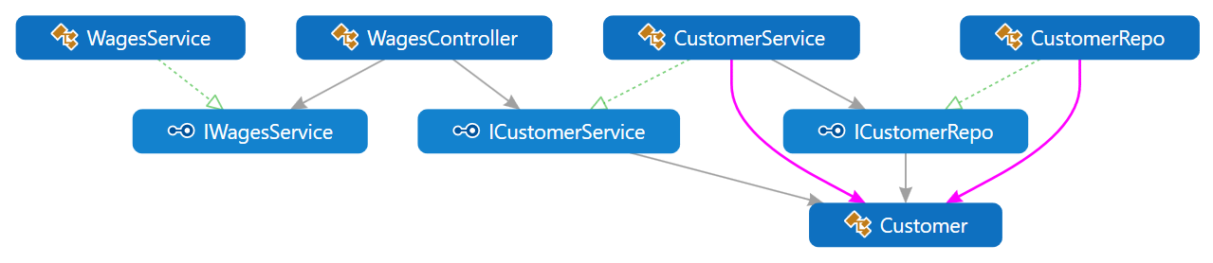
Single-responsibility Principle
A class should have one and only one reason to change,
meaning that a class should have only one job

Slide 25
SOLID
Open-closed principle

Slide 26
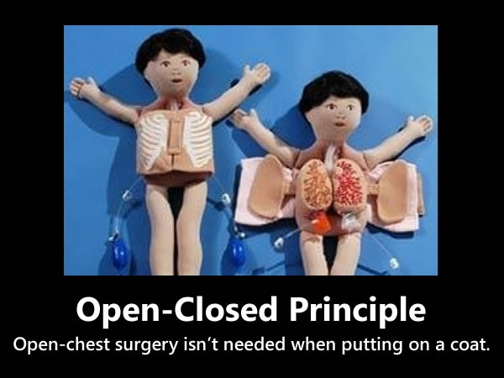

Slide 27
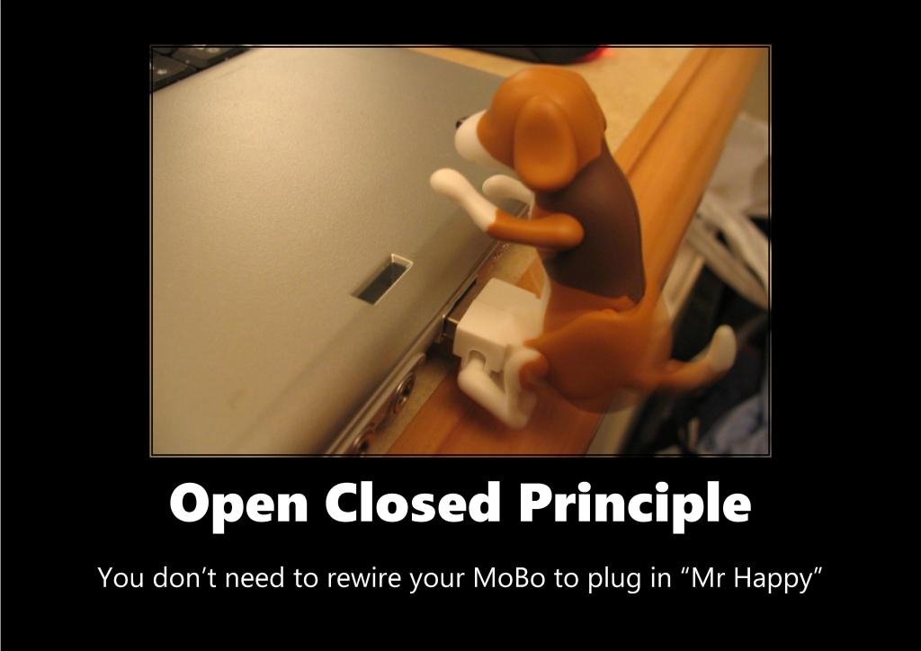

Slide 28
Open-closed principle
You should be able to extend a classes behavior, without modifying it
Open for extension
Class behavior can be extended
Closed for modification
Don’t change the classes
Bug fixes need to be fixed
Notes:
How can something be open and closed?! A class follows the OCP if it fulfills these two criteria:
Open for extension
This ensures that the class behavior can be extended. As requirements change, we should be able to make a class behave in new and different ways, to meet the needs of the new requirements.
Closed for modification
The source code of such a class is set in stone, no one is allowed to make changes to the code.
How do we achieve this?
Through abstractions. In order to be able to extend the behavior of a class without changing a single line of code, we need to make abstractions. For example, if we had a system that works with different shapes as classes, we would probably have classes like Circle, Rectangle, etc. In order for a class that depends on one of these classes to implement OCP, we need to introduce a Shape interface/class. Then, wherever we had Dependency Injection, we would inject a Shape instance instead of an instance of a lower-level class. This would give us the luxury of adding new shapes without having to change the dependent classes’ source code.
How do we know whether to make Shape a class or an interface? For that, we’ve got the Liskov Substitution Principle, which tells us when inheritance is suitable. Let’s take a look, shall we?
At first thought that might sound quite academic and abstract. What it means though is that we should strive to write code that doesn’t have to be changed every time the requirements change. How we do that can differ a bit depending on the context, such as our programming language. When using Java, C# or some other statically typed language the solution often involves inheritance and polymorphism, which is what this example will illustrate.

Slide 29


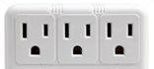
Open-closed principle
You should be able to extend a classes behavior, without modifying it
Notes:
An adapter in the wall is always closed for modification, in other words we cannot change it once it is fitted or extended if we want more.
But an adapter always provides a method of extension, so we can plug in an extension board of an adapter for more adaptation.
So you plug in an extension board and extend an existing electric adapter fitted in wall

Slide 30
Open-closed principle
You should be able to extend a classes behavior, without modifying it
public class SavingAccount{
public decimal CalculateInterest(AccountType accountType)
{
if (accountType == AccountType.Regular)
{
// calculate regular
}
else if (accountType == AccountType.Salary)
{
// calculate salary
}
return 506;
}
}

Slide 31
Open-closed principle
You should be able to extend a classes behavior, without modifying it
public class SavingAccount{
public decimal CalculateInterest(AccountType accountType)
{
if (accountType == AccountType.Regular)
{
// calculate regular
}
else if (accountType == AccountType.Salary)
{
// calculate salary
}
return 506;
}
}
What if there is a new AccountType
Notes:
So the implementation is not following the Open Closed principle because if tomorrow the bank introduces a new SavingAccount type then there is a requirement to modify this method for adding a new case for the new account type. An example is if the bank introduces a “Child Savings Account type” requiring a new condition for calculating the interest for this account type. That means that the method is always open for modification.
One more thing to note here is that the method is also not following the Single Responsibility Principle. Since here the method is doing more than one thing, like calculating interest for more than one type.
Disadvantage of not following Open Closed Principle Since a class or function always allows the addition of new logic, whenever new logic is added it is always necessary to test for full functionality. That requires the addition of a new test case for the added functionality and might also require the modification of an existing test case that fails because of added functionality.
It also breaks the Single Responsibility Principle since a class or function might end up doing multiple tasks.
Class or function maintenance becomes difficult since a class or function can become thousands of lines of code that is difficult to understand.
How to Identify not following Open Closed Principle
A class or function is always open for modification, in other words always allows adding more logic to it. Like in the preceding example.

Slide 32
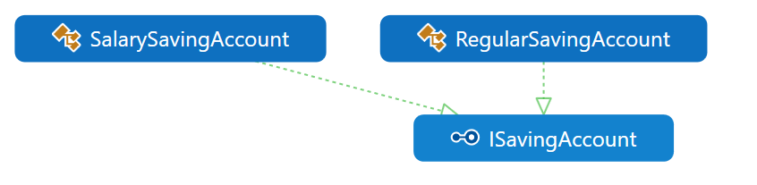
Open-closed principle
You should be able to extend a classes behavior, without modifying it

Slide 33
SOLID
Liskov substitution principle

Slide 34
Liskov substitution principle
Derived classes must be substitutable for their base classes.
Let Φ(x) be a property provable about objects x of type T. Then Φ(y) should be true for objects y of type S where S is a subtype of T.
Notes:
What is wanted here is something like the following substitution property: If for each object o1 of type S there is an object o2 of type T such that for all programs P defined in terms of T, the behavior of P is unchanged when o1 is substituted for o2 then S is a subtype of T.

Slide 35
Liskov substitution principle
Derived classes must be substitutable for their base classes.
Objects of a superclass shall be replaceable with objects of its subclasses
Objects of your subclasses behave in the same way as the ones from the superclass
Notes:
In mathematics, a Square is a Rectangle. Indeed it is a specialization of a rectangle. The "is a" makes you want to model this with inheritance. However if in code you made Square derive from Rectangle, then a Square should be usable anywhere you expect a Rectangle. This makes for some strange behavior.
Imagine you had SetWidth and SetHeight methods on your Rectangle base class; this seems perfectly logical. However if your Rectangle reference pointed to a Square, then SetWidth and SetHeight doesn't make sense because setting one would change the other to match it. In this case Square fails the Liskov Substitution Test with Rectangle and the abstraction of having Squareinherit from Rectangle is a bad one.

Slide 36
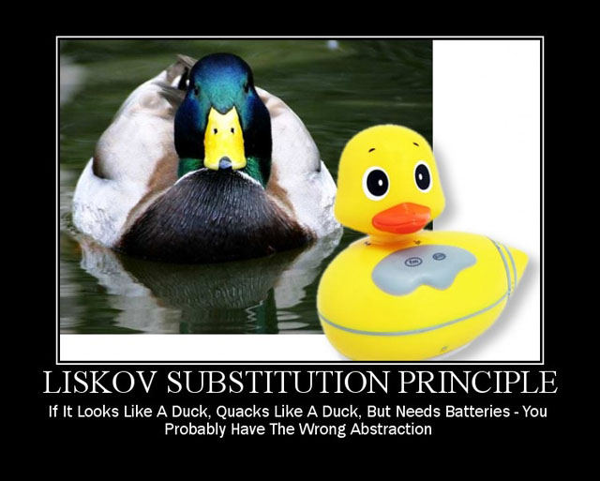

Slide 37
public interface IDuck{
void Swim();
bool IsSwimming { get; }
}
public class NormalDuck : IDuck{
public void Swim(){// swim swim swim}
public bool IsSwimming { get { return true; /* if the duck is swimming */
}
public class ElectrickDuck : IDuck{
bool _isSwimming;
public bool IsTurnedOn { get; set; }
public void Swim()
{
if (!IsTurnedOn) return;
_isSwimming = true;
}
public bool IsSwimming { get { return _isSwimming; } }
}

Slide 38
public interface IDuck{
void Swim();
bool IsSwimming { get; }
}
public class NormalDuck : IDuck{
public void Swim(){// swim swim swim}
public bool IsSwimming { get { return true; /* if the duck is swimming */
}
public class ElectrickDuck : IDuck{
bool _isSwimming;
public bool IsTurnedOn { get; set; }
public void Swim()
{
if (!IsTurnedOn) return;
_isSwimming = true;
}
public bool IsSwimming { get { return _isSwimming; } }
}
Breaks the LSP because it must be turned on

Slide 39
SOLID
Interface segregation principle

Slide 40
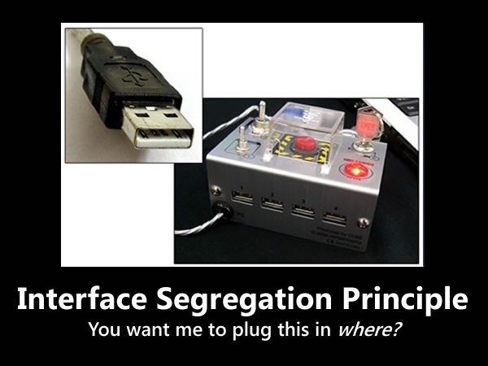
Notes:
The “I” in SOLID is for Interface Segregation Principle, which states that clients should not be forced to depend on methods they don’t use. If a class exposes so many members that those members can be broken down into groups that serve different clients that don’t use members from the other groups, you should think about exposing those member groups as separate interfaces.

Slide 41
Interface segregation principle
A client should never be forced to implement an interface that it doesn't use or clients shouldn't be forced to depend on methods they do not use.
Better to have many smaller interfaces, than fewer, fatter interfaces
If a class exposes so many members that those members can be broken down into groups that serve different clients that don’t use members from the other groups, you should think about exposing those member groups as separate interfaces.

Slide 42
SOLID
Dependency Inversion Principle

Slide 43
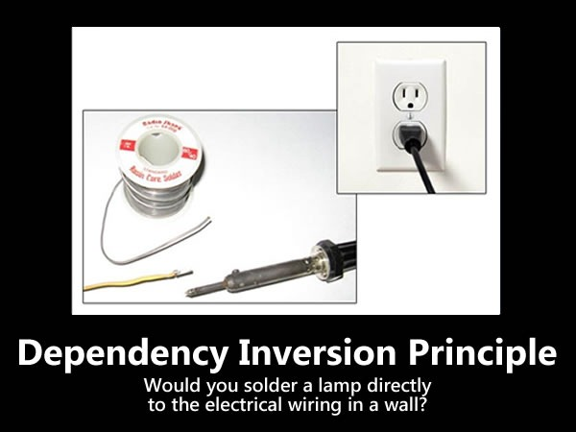

Slide 44
Dependency Inversion Principle
Depend on abstractions, not on concretions..
high-level modules shouldn’t depend on low-level modules, but both should depend on shared abstractions. In addition, abstractions should not depend on details – instead, details should depend on abstractions.
Allows decoupling
Notes:
Let’s say we have a system that handles authentication through external services such as Google, GitHub, etc. We would have a class for each service: GoogleAuthenticationService, GitHubAuthenticationService, etc. Now, let’s say that some place in our system, we need to authenticate our user. To do that, as mentioned, we have several services available. To be able to make use of all the services, we have two possibilities: We either write a piece of code that adapts each service to the authentication process, or we define an abstraction of the authentication services. The first possibility is a dirty solution that will potentially introduce technical debt in the future; in case a new authentication service is to be integrated to the system, we will need to change the code, which as a result violates the OCP. The second possibility is much cleaner, it allows for future addition of services, and changes can be done to each service without changing the integration logic. By defining a AuthenticationService interface and implementing it in each service, we would then be able to use Dependency Injection in our authentication logic and have our authentication method signature look something like this: authenticate(AuthenticationService authenticationService). Then, we could authenticate by a specific service like this: authenticate(new GoogleAuthenticationService). This helps us generalize the authentication logic without having to integrate each service separately.

Slide 45
Dependency Inversion Principle
Depend on abstractions, not on concretions..
class PasswordReminder
{
private SQLConnection _dbConnection;
public PasswordReminder(SQLConnection conn)
{
this._dbConnection = conn;
}
}
Notes:
Later if you were to change the database engine, you would also have to edit the PasswordReminder class and thus violates Open-close principle.
The PasswordReminder class should not care what database your application uses, to fix this again we "code to an interface", since high level and low level modules should depend on abstraction, we can create an interface:

Slide 46
Dependency Inversion Principle
Depend on abstractions, not on concretions..
High level
class PasswordReminder
{
private SQLConnection _dbConnection;
public PasswordReminder(SQLConnection conn)
{
this._dbConnection = conn;
}
}
Low level

Slide 47
Need to knows
2
Extension methods

Slide 48
Need to knows
3
async / await

Slide 49
public async Task DoSomethingAsync()
{
await Task.Delay(100);
}
Notes:
The “async” keyword enables the “await” keyword in that method and changes how method results are handled. That’s all the async keyword does! It does not run this method on a thread pool thread, or do any other kind of magic. The async keyword only enables the await keyword (and manages the method results).
The beginning of an async method is executed just like any other method. That is, it runs synchronously until it hits an “await” (or throws an exception).
The “await” keyword is where things can get asynchronous. Await is like a unary operator: it takes a single argument, an awaitable (an “awaitable” is an asynchronous operation). Await examines that awaitable to see if it has already completed; if the awaitable has already completed, then the method just continues running (synchronously, just like a regular method).
If “await” sees that the awaitable has not completed, then it acts asynchronously. It tells the awaitable to run the remainder of the method when it completes, and then returns from the async method.
Later on, when the awaitable completes, it will execute the remainder of the async method. If you’re awaiting a built-in awaitable (such as a task), then the remainder of the async method will execute on a “context” that was captured before the “await” returned.
I like to think of “await” as an “asynchronous wait”. That is to say, the async method pauses until the awaitable is complete (so it waits), but the actual thread is not blocked (so it’s asynchronous).

Slide 50
Doesn’t do anything special,
it just enables the await keyword
public async Task DoSomethingAsync()
{
await Task.Delay(100);
}

Slide 51
await
Awaitable is an asynchronous operation
Await examines the awaitable to see if it has already completed
If the awaitable has already completed, the method just continues running
If the “await” sees that the awaitable has not completed, then it acts asynchronously.
“await” takes a single argument – the awaitable
2 types
Task<T>
Task

Slide 52
Return types
Async methods can return Task<T>, Task or void
Task<T> and Task are awaitable
void is not
public async Task<int> DoSomethingAsync()
{
await Task.Delay(100);
return 42;
}

Slide 53
Context
When you await a built-in awaitable, then the awaitable will capture the current “context”
If you are on a UI thread, then it’s the UI context
If you are responding to an ASP.NET request, then it’s an ASP.NET request context
Notes:
https://www.carlrippon.com/scalable-and-performant-asp-net-core-web-apis-asynchronous-operations/

